Slide 1

Students Awareness Program
on
Dog Bite Prevention
Speaker
MRS. Chitra Goyani

Slide 2
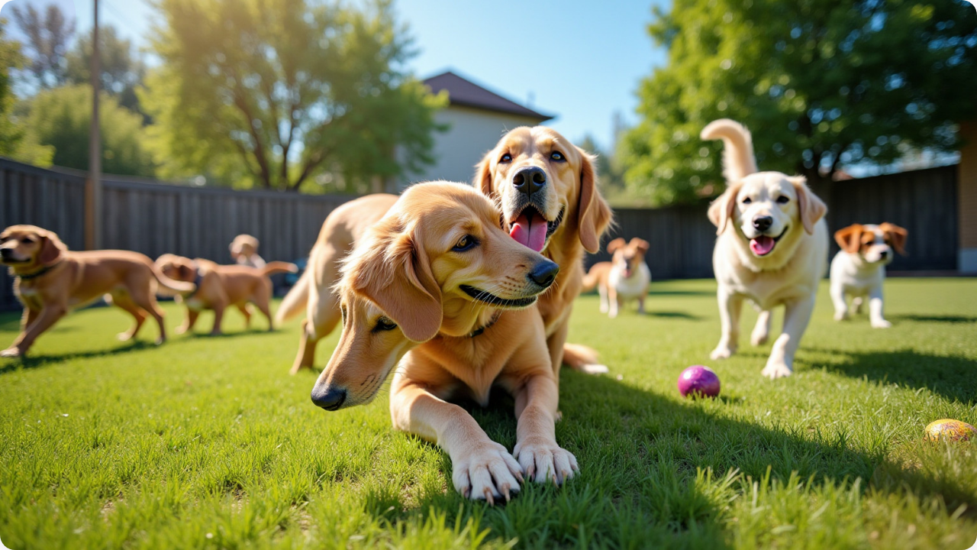
A Student's Guide to Dog Bite Prevention

Slide 3


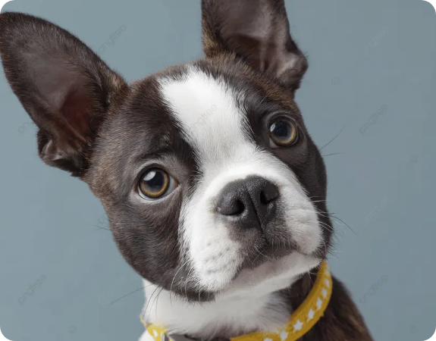
Dogs are Our Friends!
Dogs make wonderful companions. They are fun, loyal, and loving.
However, just like people, dogs have feelings too. Sometimes they are happy, but sometimes they can be scared or grumpy.
To keep everyone safe, we need to learn how to understand what they are saying!

Slide 4

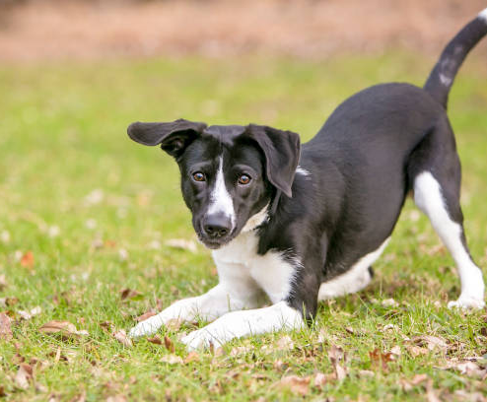
Is the Dog Happy?
Look for these signs:
Wagging Tail: Usually means "I am happy!" (but check the whole body).
Play Bow: Front elbows down, bottom up. This means "Let's play!"
Relaxed Mouth: Mouth slightly open, tongue might be out.
Soft Eyes: Eyes look normal, not staring hard.

Slide 5


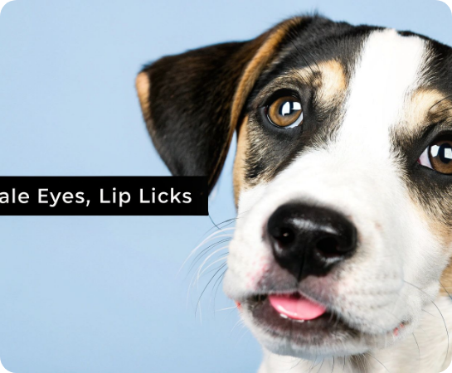
When to Stay Away
Warning Signs (I need space!):
Whale Eye: Showing the whites of their eyes.
Lip Licking: Licking lips when no food is nearby.
Yawning: A big yawn when they are not tired (means stress).
Rigid Body: Standing very stiff and still.
Growling: A clear warning to back off.

Slide 6

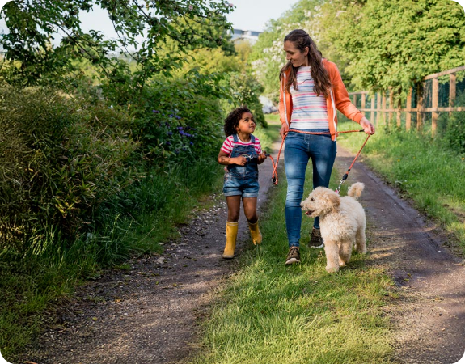
The Golden Rule: ASK
The 3 Steps:
1. ASK: Always ask the owner: "May I pet your dog?"
2. WAIT: Let the dog sniff your closed fist. If they pull away, stop.
3. PET: If the dog is happy, pet gently on the side or back. Never pat the top of the head!

Slide 7
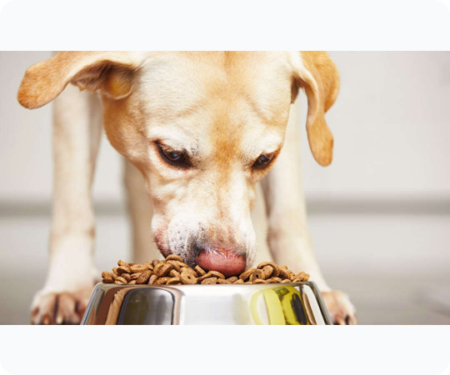

Do Not Disturb!
Never touch a dog when:
•
They are eating or drinking.
•
They are sleeping.
•
They are caring for puppies.
•
They are behind a fence or in a car.
•
They are injured or sick.
•
There is no owner around.

Slide 8

Be a Tree
If a loose dog approaches:
1. STOP: Stand very still.
2. FOLD BRANCHES: Clasp your hands in front of you.
3. WATCH ROOTS: Look at your feet (avoid eye contact).
4. BREATHE: Count to yourself until the dog goes away.
Boring trees are not fun to chase!

Slide 9
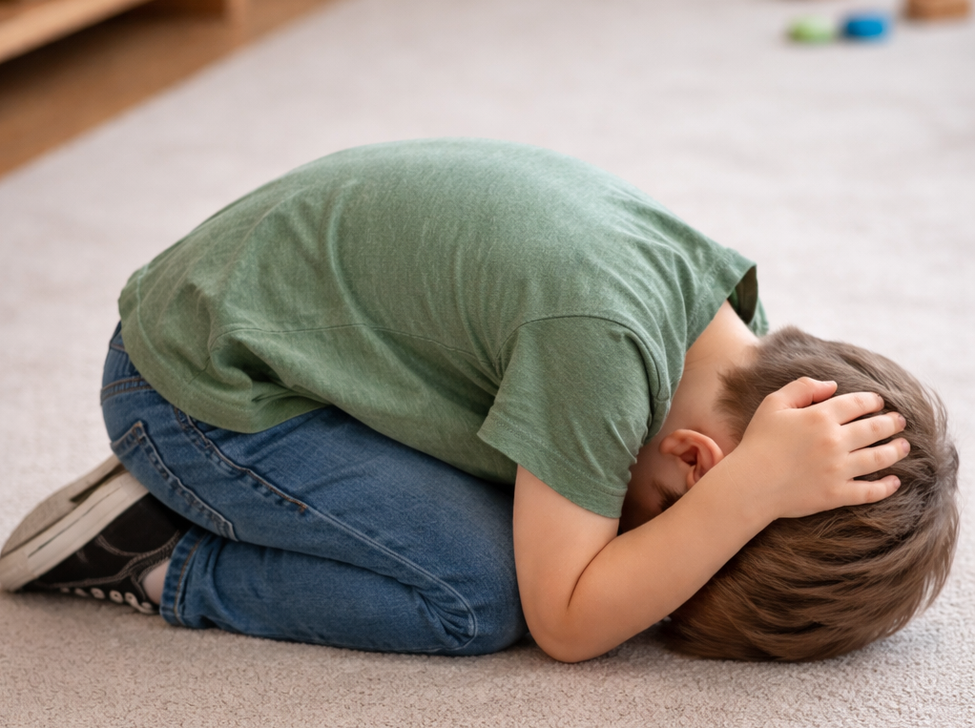
Be a Rock
If you are knocked down:
If a dog jumps on you or knocks you over, protect yourself by becoming a rock.
Curl up into a tight ball on your knees.
Cover your head and ears with your hands.
Stay completely still and quiet.
Wait for help to arrive.

Slide 10

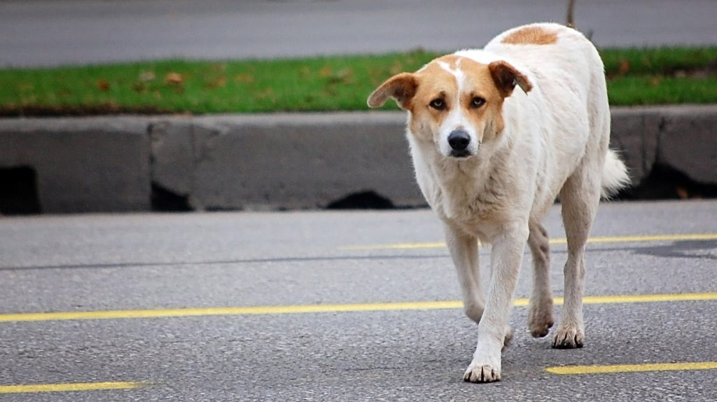
Stray Dog Safety
Street Smart Rules:
Never Run: Running triggers a dog's chase instinct. Walk slowly.
No Eye Contact: Staring is a challenge. Look away.
Avoid Packs: Stay away from groups of street dogs.
Don't Feed: Do not try to feed stray dogs by hand.

Slide 11
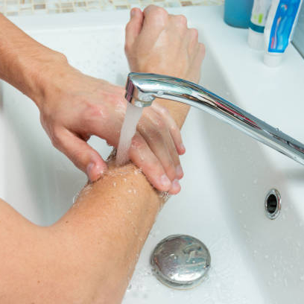

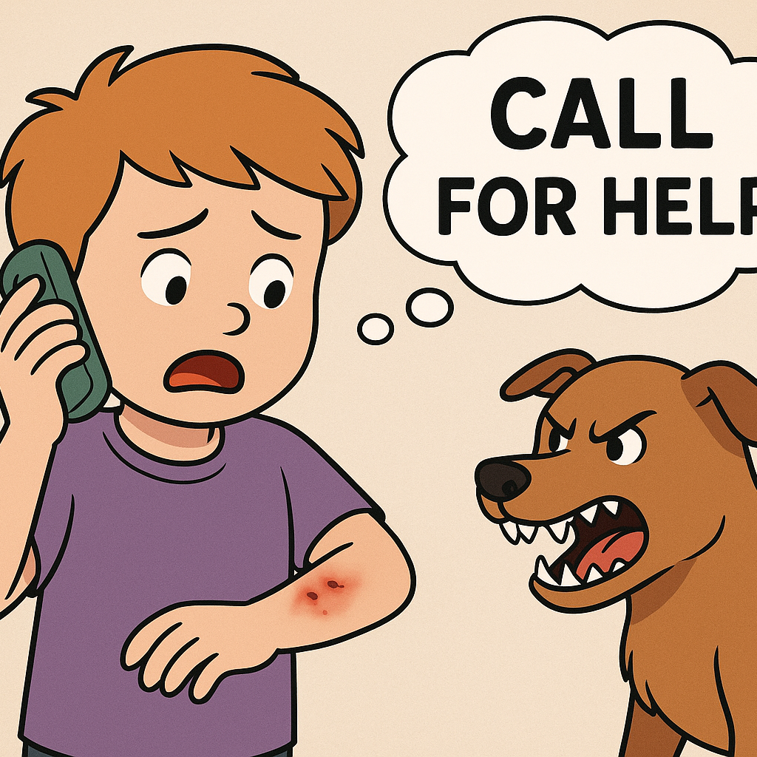
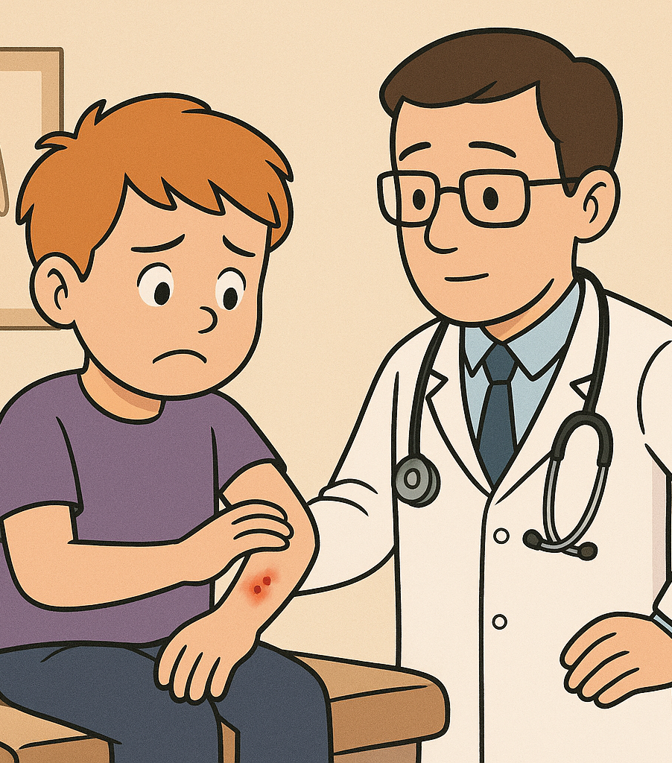
If You Get Bitten
1. Wash your would
2. Tell an adult
3. Visit a Doctor

Slide 12


Step 1: The 15-Minute Rule
Wash Immediately!
This is the most critical step.
1. Use soap and running water.
2. Wash the wound for at least 15 minutes.
3. This washes away the saliva that carries viruses.
4. Apply an antiseptic like Betadine or alcohol afterwards.

Slide 13

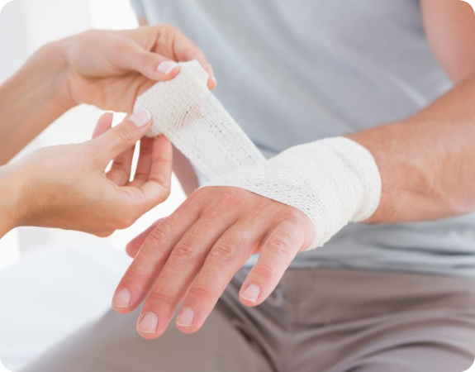
Step 2: Stop the Bleeding
Control the Wound
Apply Pressure: Use a clean cloth or sterile gauze pad to press gently on the wound.
Elevate: If the bite is on a hand or leg, raise it above the heart to slow bleeding.
Cover: Once bleeding slows, cover with a sterile bandage.

Slide 14






Step 3: Seek Medical Help
Go Now
Tetanus
Rabies
Visit a doctor or hospital immediately. Dog bites can cause serious infections deep inside the skin.
You may need a Tetanus shot if you haven't had one in the last 5-10 years.
The doctor will decide if you need the Rabies vaccine. This is a life-saving shield!

Slide 15

The Rabies Shield
Vaccination Schedule
Rabies is 100% fatal if ignored, but 100% preventable with vaccines!
If the doctor prescribes it, you must complete the full course.
Typical Schedule (days):
0 (Day of bite), 3, 7, 14, and 28.
Never miss a dose!

Slide 16


Gather Information
What to ask the owner:
Contact Info: Name and phone number.
Vaccination: Is the dog vaccinated against Rabies? Ask for proof.
Behavior: Was the dog provoked, or did it bite for no reason?
Time: Note the exact time of the incident.

Slide 17


The "Do" & "Don't" List
Please DON'T:
Please DO:
Don't hide the bite from parents.
Wash the wound immediately.
Don't apply chili powder, turmeric, or coffee to the wound.
Tell an adult right away.
See a doctor within 24 hours.
Don't bandage immediately without washing.
Complete all your vaccine doses.
Don't chase or hurt the dog.

Slide 18
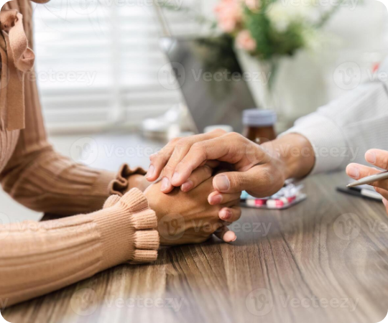
It's Okay to be Scared
Healing Inside & Out
Getting bitten can be very scary. You might feel afraid of dogs for a while.
This is normal! Talk to your parents, teachers, or a counselor about your feelings.
With time and support, you will feel brave again.

Slide 19


I am a Dog Safety Hero!
My Pledge:
I will always ASK before petting.
I will STAND like a TREE if scared.
I will NOT disturb sleeping dogs.
I will TELL an adult if I see a loose dog.
I will respect all dogs!

Slide 20

Questions?
Stay Safe & Be Kind to Animals!
Animal Rescue Call 98254 80908
http://www.natureclubsurat.org

